Slide 1
A data-driven approach to understand heat islands and prioritize future observations in Petersburg, VA, USA
DATA SCIENCE FOR THE PUBLIC GOOD
Summer 2024
Munso Bwalya, Chandler Henderson, Raven Mott, Matthew Whalen
Virginia State University
2 August 2024
Notes:
A data-driven approach to understand heat islands and prioritize future observations in Petersburg, VA, USA

Slide 2


Slide 3
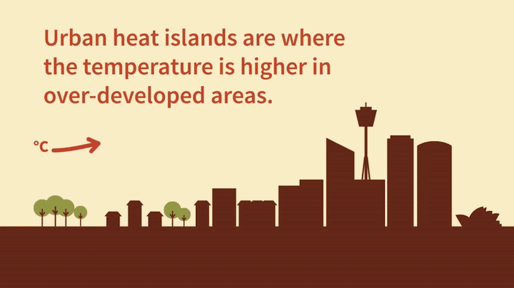

Slide 4
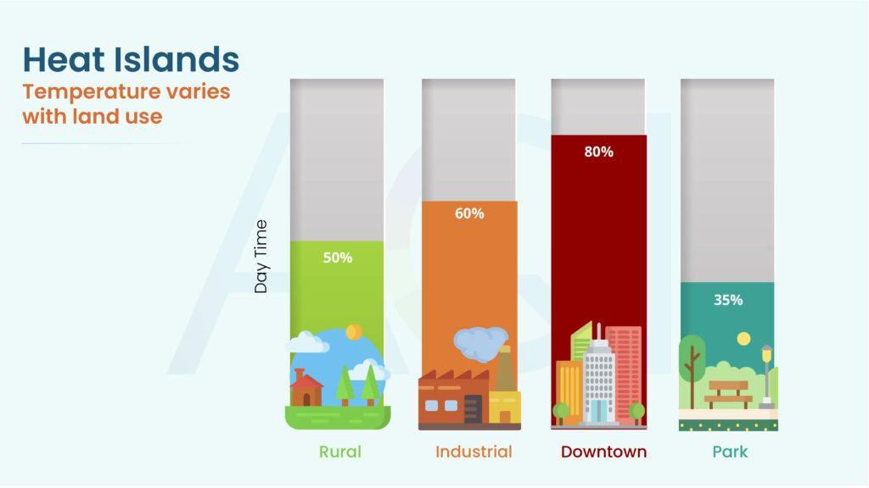
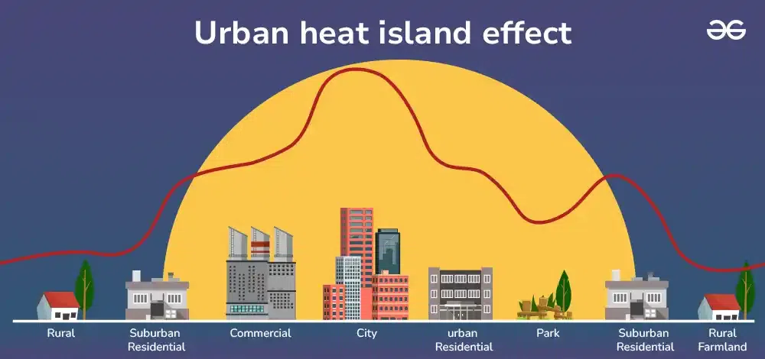

Slide 5
Research Objective
Examine the influence of socioeconomic
factors, tree cover, and building density on
temperature in Petersburg, VA.

Slide 6


Hypotheses.
Temperature is negatively correlated with tree cover
Because people live in high density in cities, requiring tall buildings and cutting trees, temperature is positively correlated with population density, building density, and building height

Slide 7
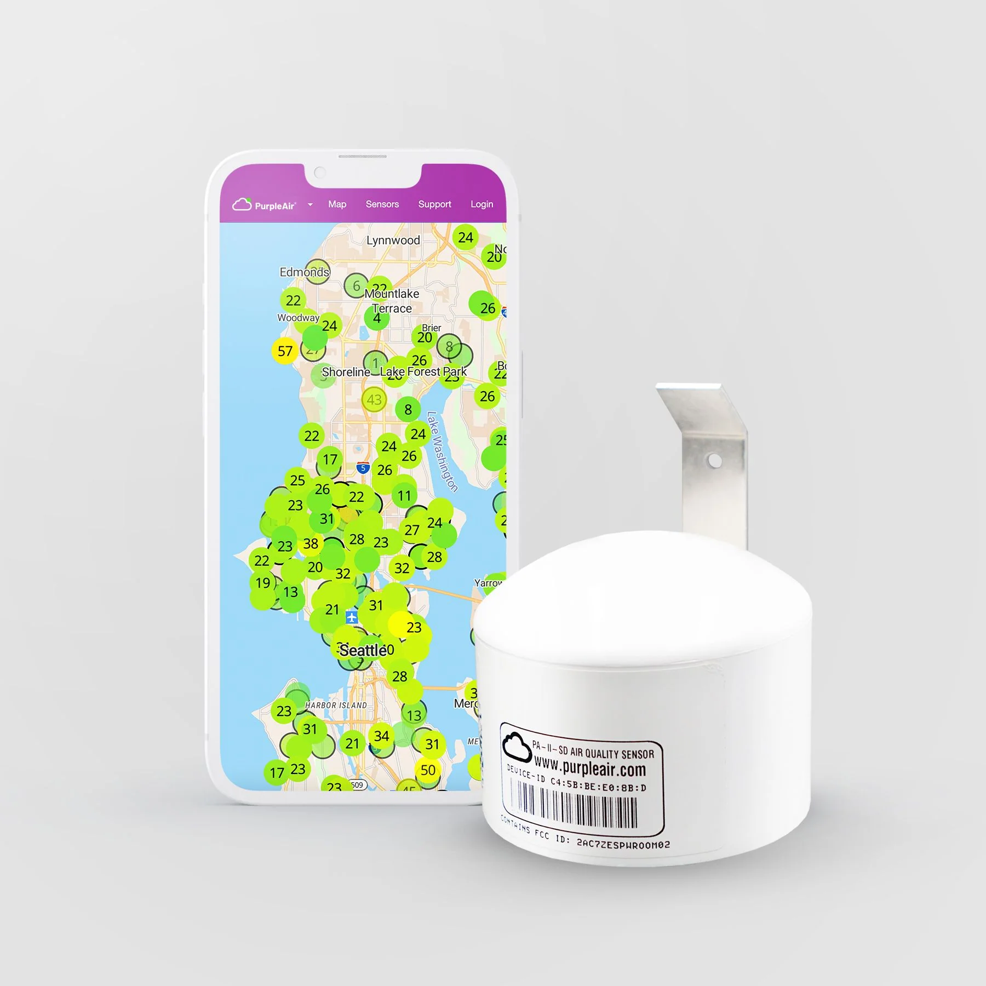
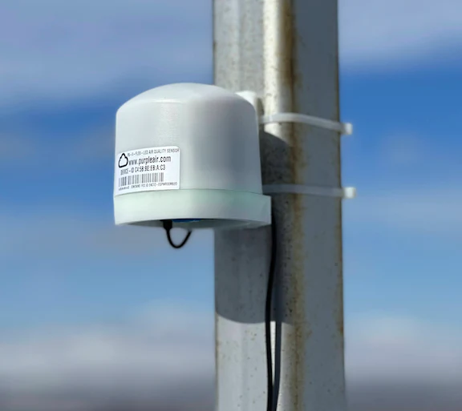
PurpleAir Monitors
purpleair.com
We have an opportunity to measure temperature in Petersburg using data collected over time
PurpleAir monitors are low cost and measure temperature, humidity, and air particles relevant to human health
Part of the purpose of this project is to prioritize locations for PurpleAir Monitors in Petersburg

Slide 8

Data Sources.
Variables and Sources:
Temperature (mean/max) - heat island study from Virginia Foundation of Independent Colleges - July 15 2021 snapshot
Tree cover (%) - satellite data (courtesy Green Infrastructure Center)
Population size and Median income - American Community survey (via ‘tidycensus” R package)
Building density and heights - Overture Maps Foundation
Notes:
VFIC = Virginia Foundation of Independent Colleges
GIC = Green Infrastructure Center (U Virginia)

Slide 9
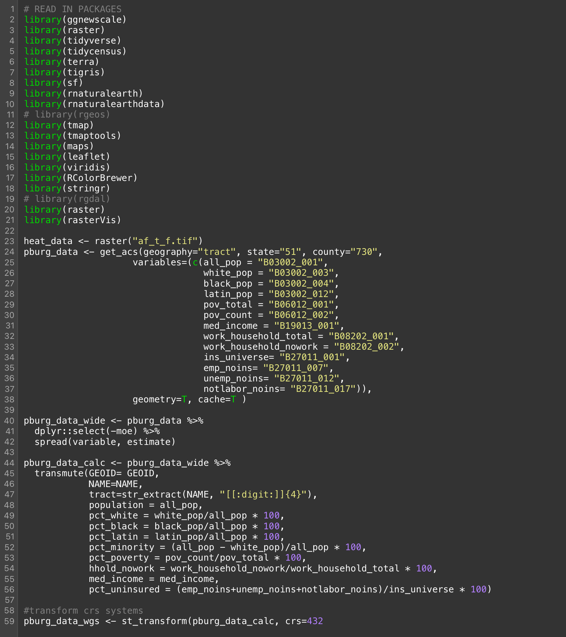
Data Analysis.
Completed using R
Map making + Spatial Analysis
Vector + raster data
Coordinate reference systems
Data manipulation
Summarize variables by census tract
Correlations using data summaries (n = 11)

Slide 10
Key Findings.
Census tracts capture major differences in socioeconomics and environment
Temperature is associated with tree cover
PurpleAir captures variation over time
Census tracts within Petersburg show systematic variation in measured variables
Average temperature is negatively correlated with tree cover. Population density and building density maybe be related as well.
Maximum temperatures at one of the hottest spots downtown far exceed the available snapshot estimates

Slide 11
Census tracts capture major differences in socioeconomics and environment
Census tracts within Petersburg show systematic variation in measured variables
Tract | Tree coverage(%) | Building Density (per km²) | Mean Building Height (m) | Median Income | Population Density (per km²) | Mean Temp. (°F) | Max. Temp. (°F)
8101 | 53.2 | 300.67 | 6.20 | $23,846 | 403.3 | 91.46 | 93.68
8103 | 40.6 | 610.45 | 6.55 | $45,673 | 689.4 | 91.61 | 93.93
8104 | 20.9 | 857.47 | 6.32 | $56,875 | 1820.6 | 92.02 | 93.93
8105 | 51.6 | 589.51 | 6.30 | $35,821 | 908.1 | 91.24 | 92.37
8106 | 33.1 | 931.95 | 6.04 | $24,688 | 1293.5 | 91.42 | 92.59
8107 | 39.1 | 946.5 | 6.22 | $25,385 | 1511.2 | 91.48 | 93.93
8109 | 42.3 | 748.36 | 6.43 | $71,033 | 1104.1 | 91.13 | 93.62
8110 | 59.5 | 247.66 | 6.58 | $55,918 | 499.8 | 90.93 | 93.46
8111 | 56.2 | 173.38 | 6.67 | $59,495 | 326.6 | 91.22 | 93.69
8112 | 53.1 | 173.88 | 6.58 | $49,410 | 252.7 | 91.24 | 93.72
8113 | 35.3 | 506.28 | 6.57 | $43,881 | 1100.3 | 91.99 | 93.98

Slide 12
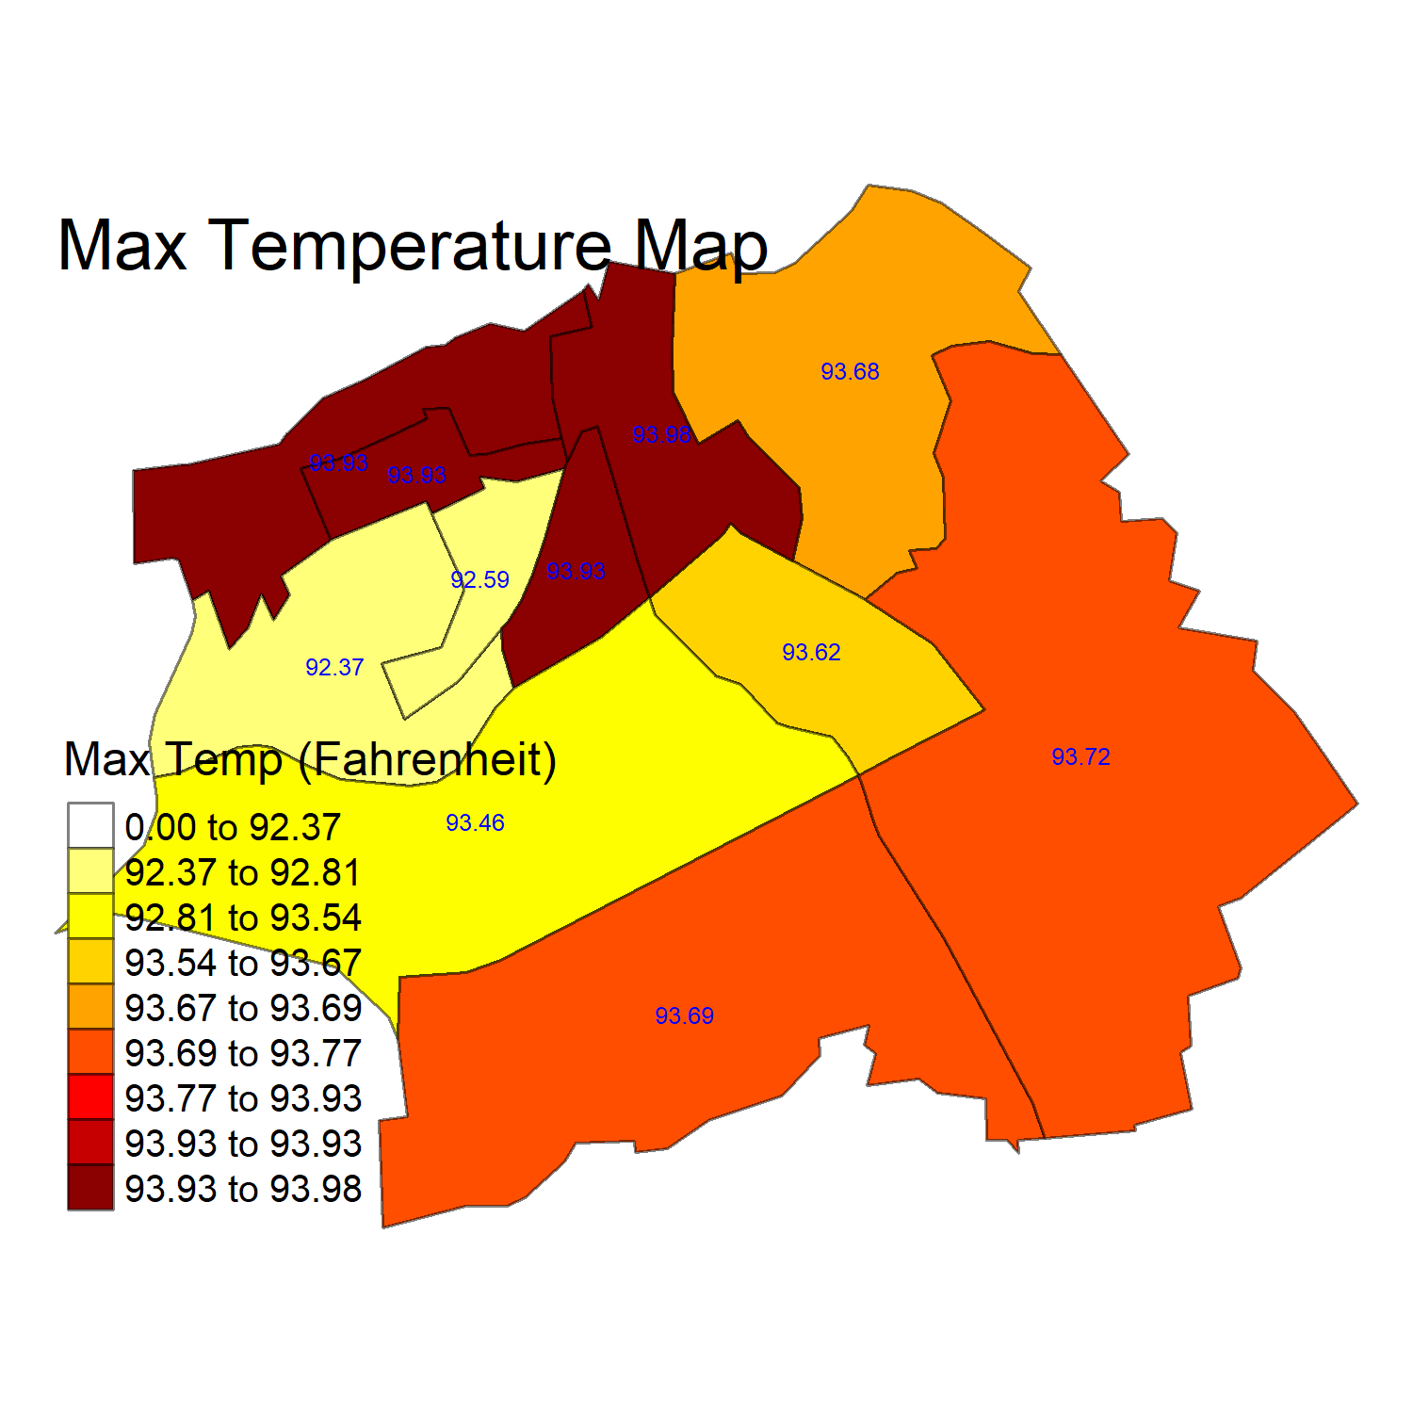
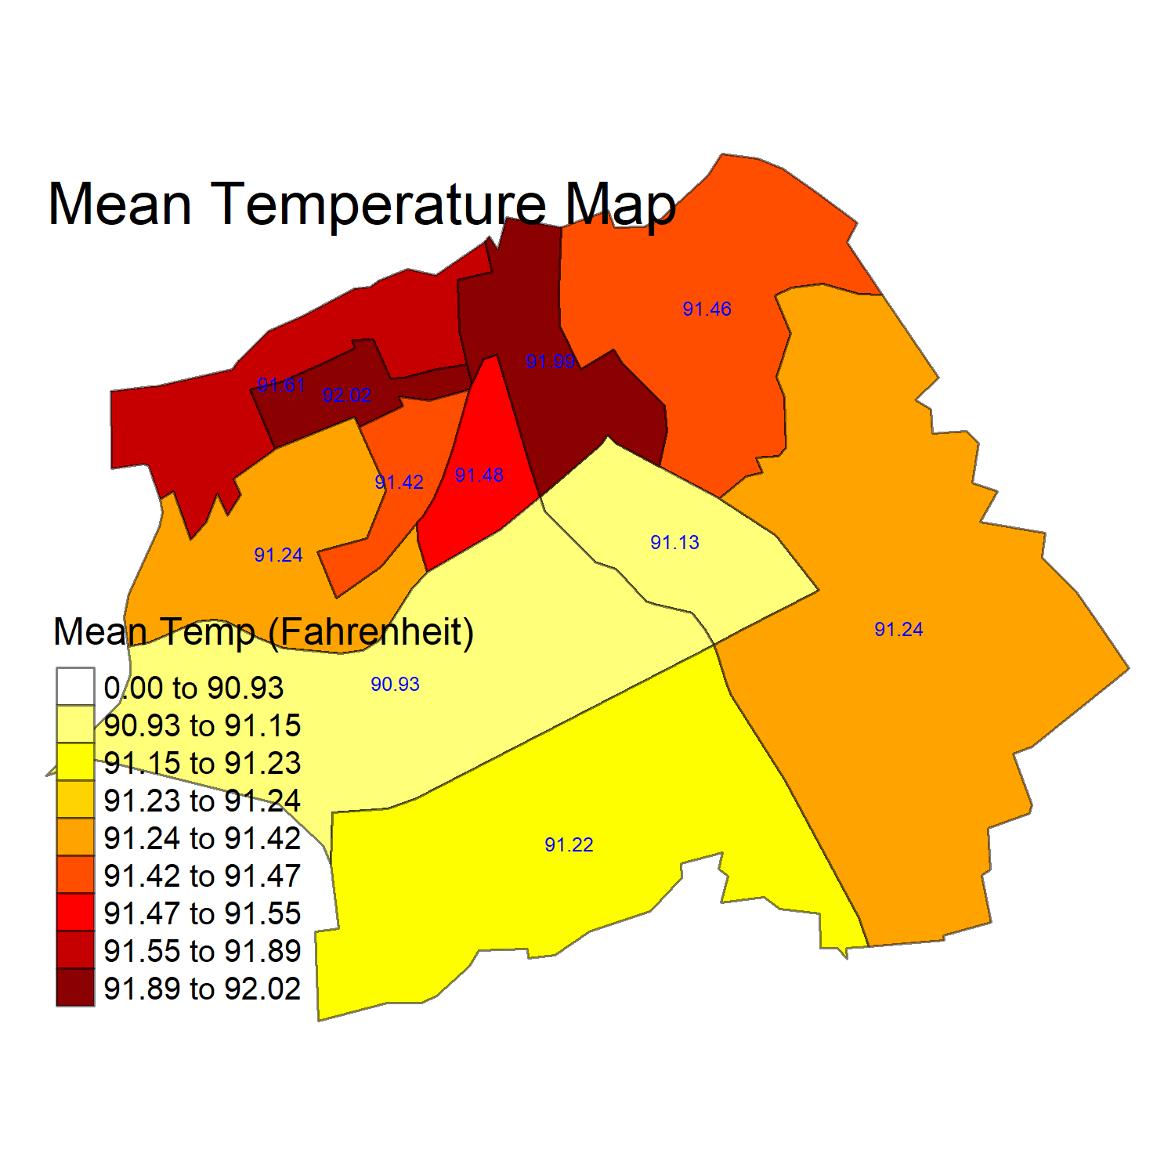
Census tracts capture major differences in socioeconomics and environment

Slide 13
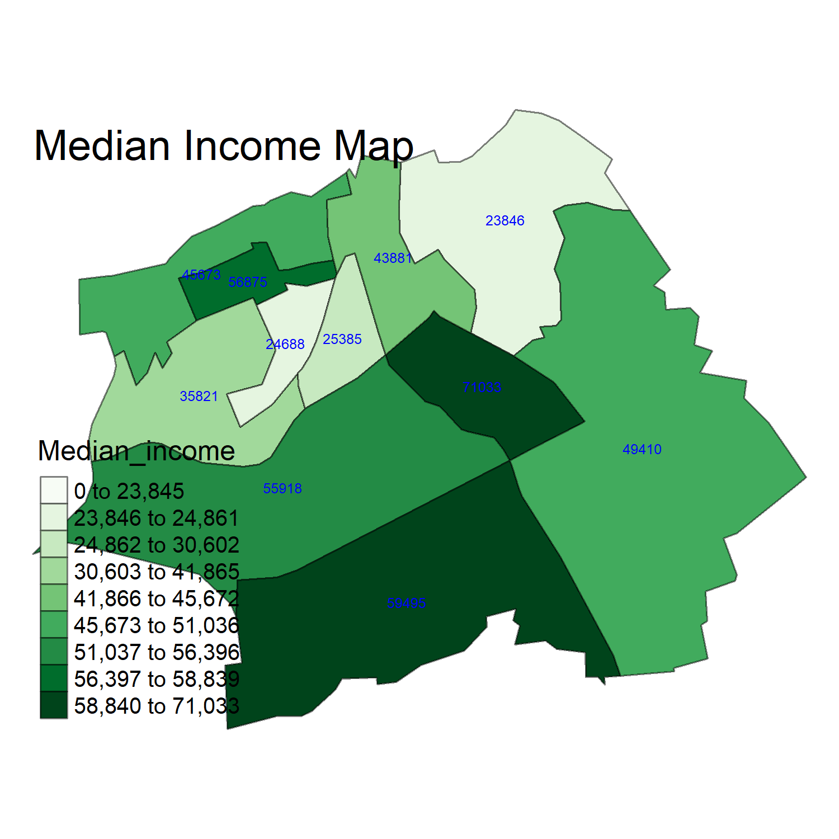
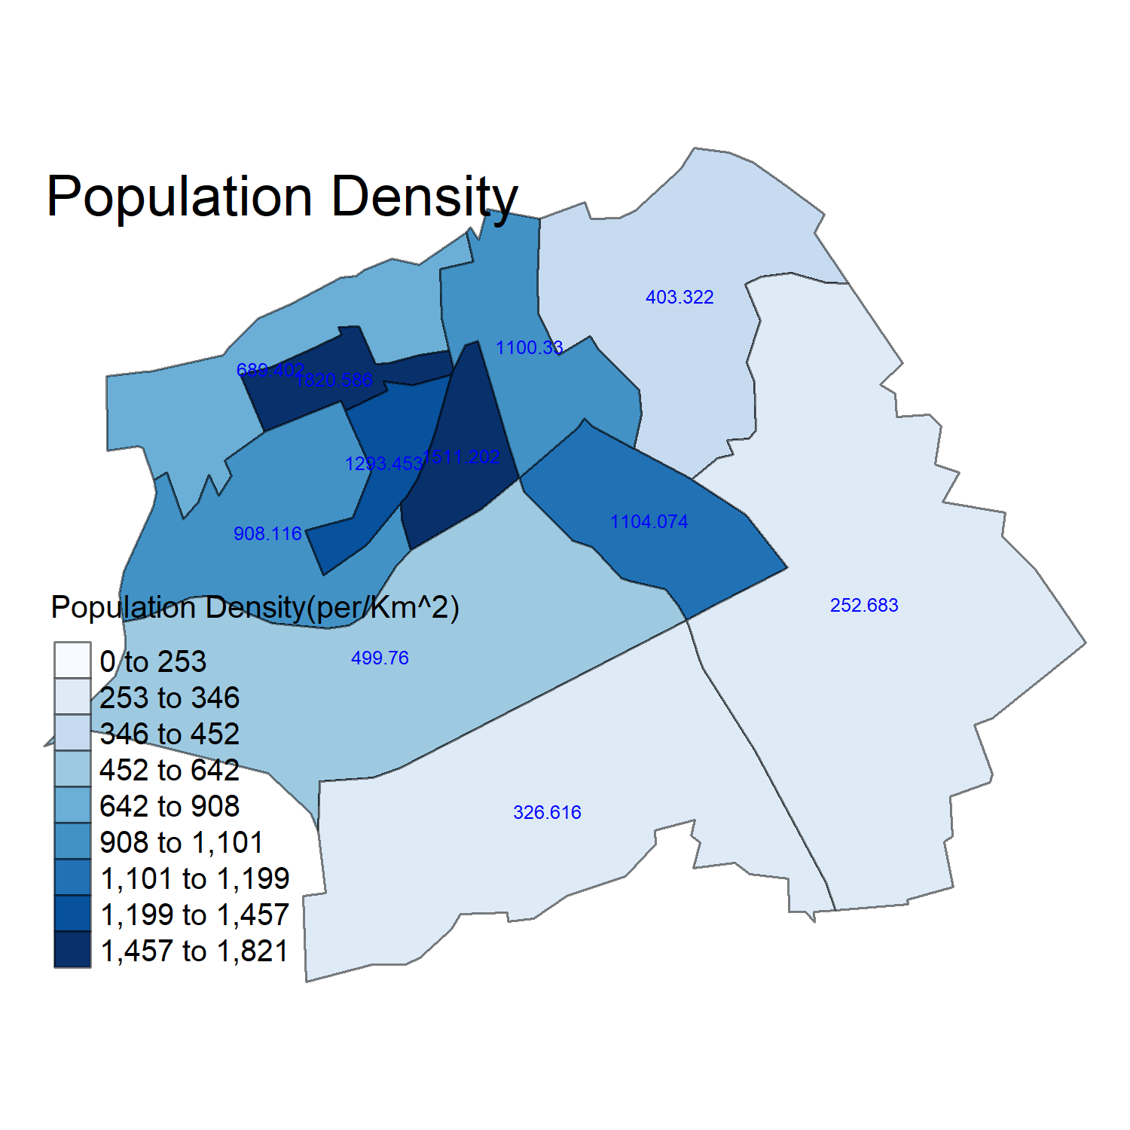
Census tracts capture major differences in socioeconomics and environment

Slide 14
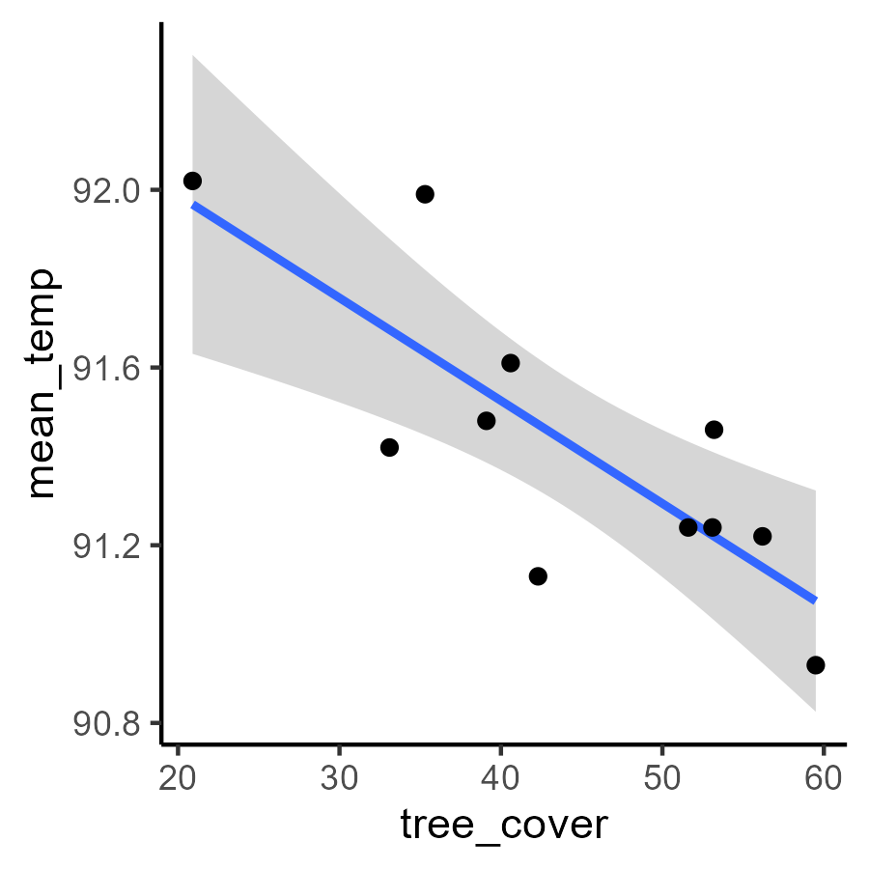
Temperature is associated with tree cover and building density
Average temperature is negatively correlated with tree cover
With every percent decrease in tree cover, average temperature increases 0.023℉
20% decline → 4.6℉ increase
R²= 0.60

Slide 15
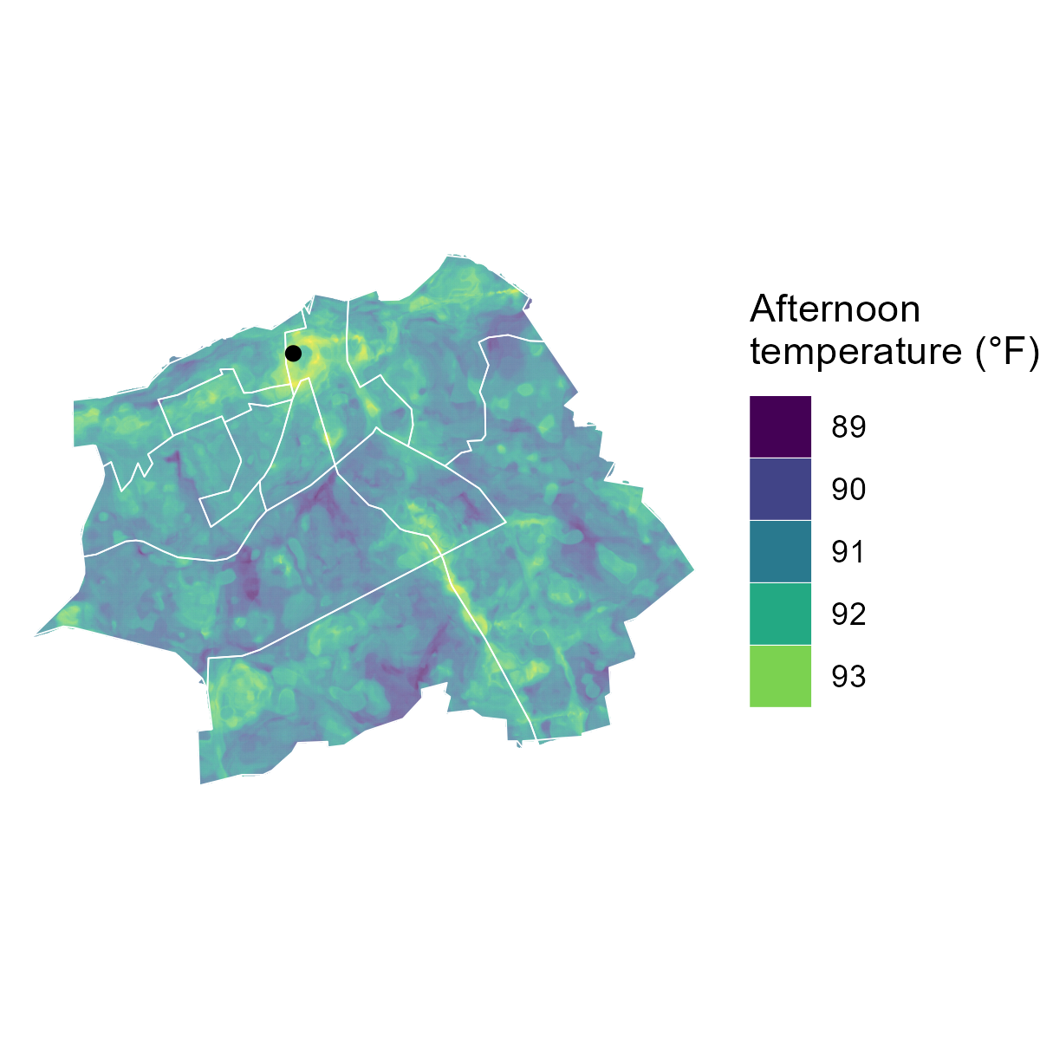
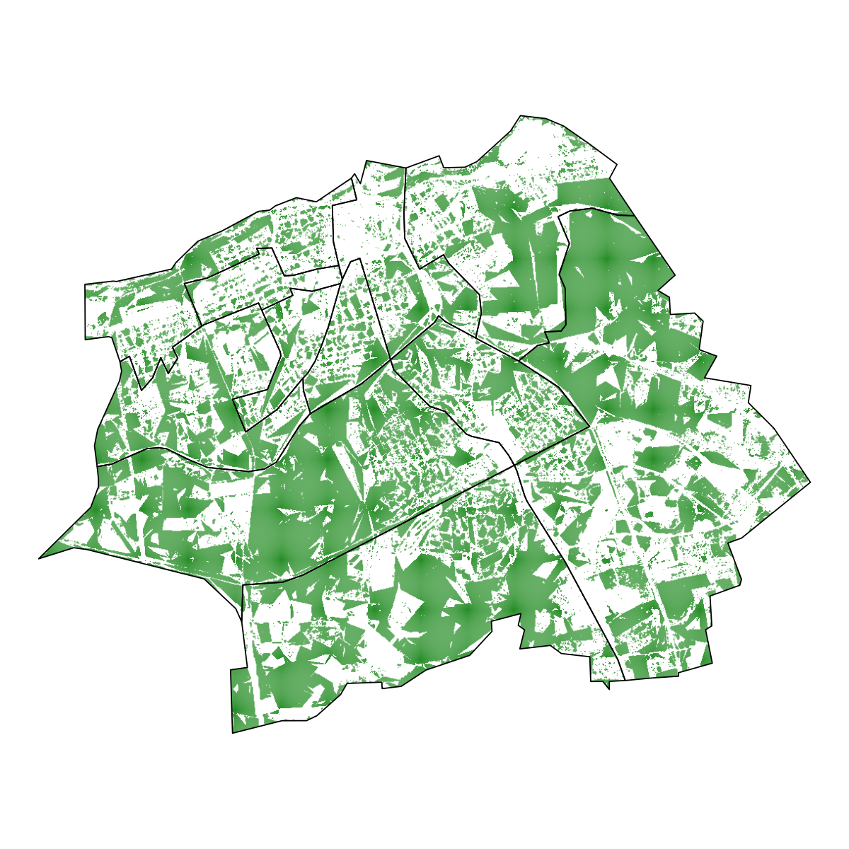
Average temperature is negatively associated with tree cover
Mean Temperature
Tree cover

Slide 16
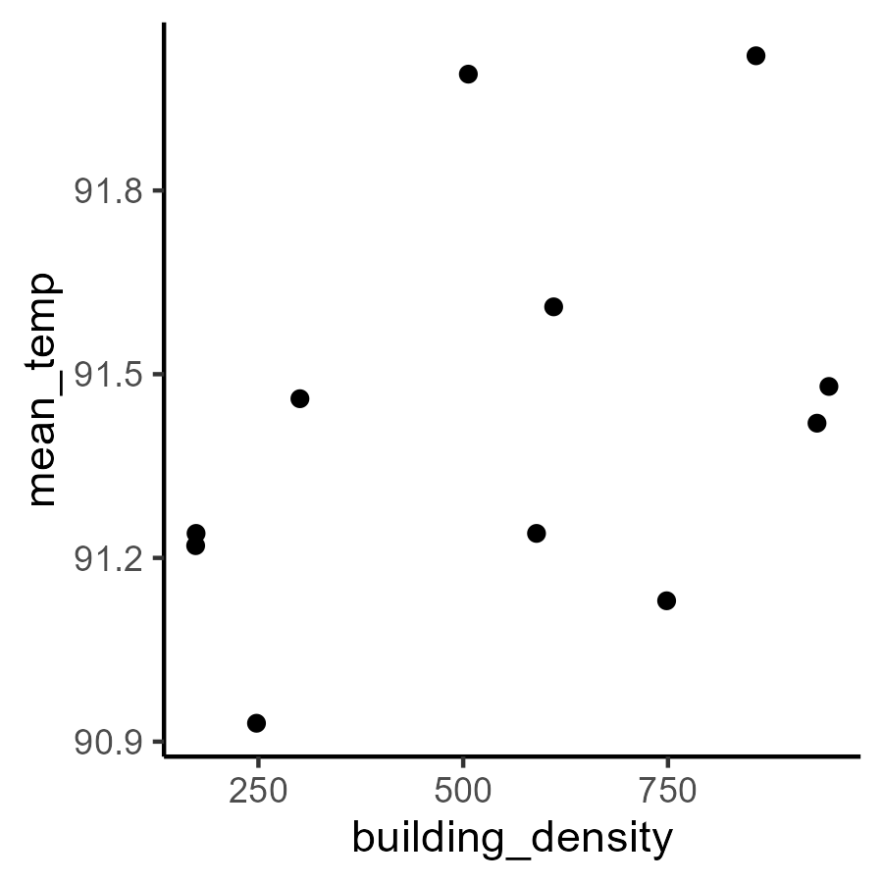
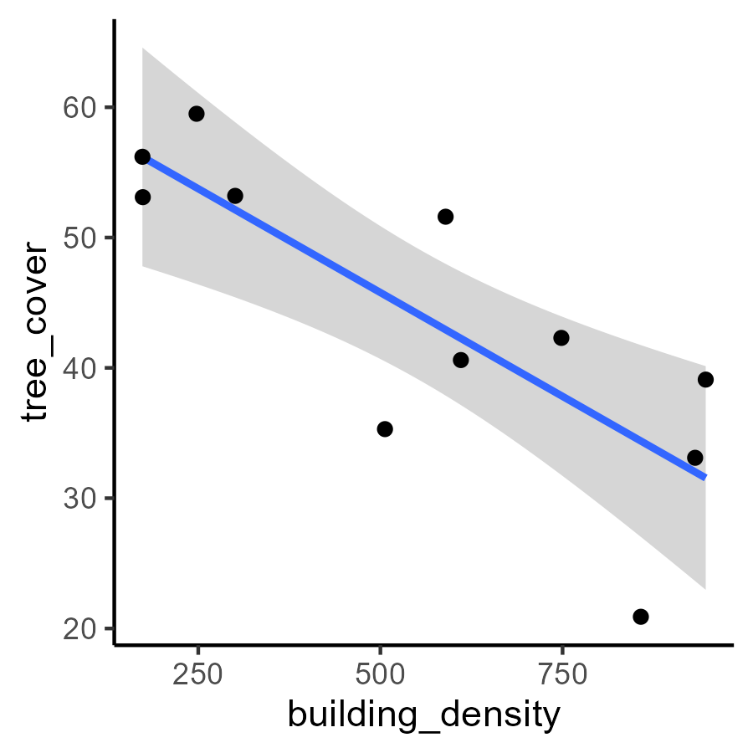
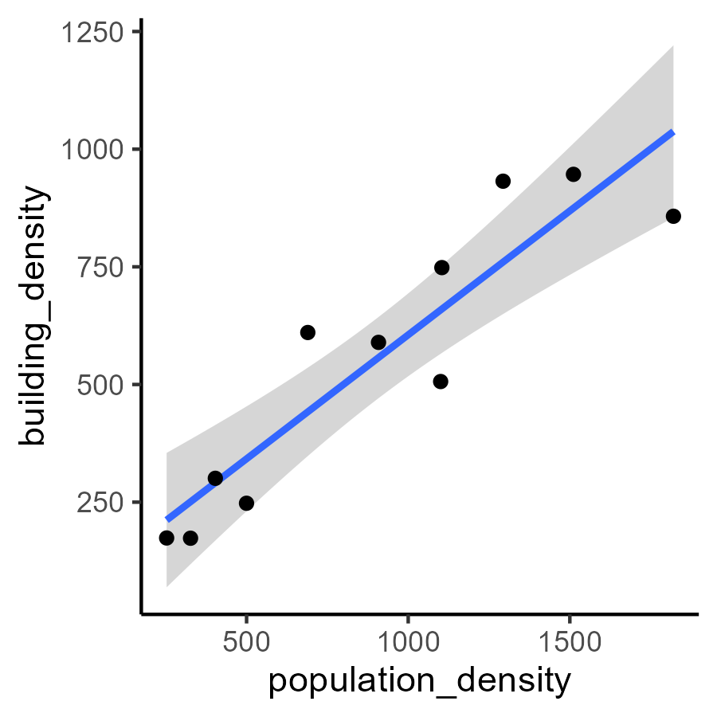
Temperature was not significantly associated with building density or height
Building density and height showed non-significant positive correlations with temperature
But. trees and buildings are closely related…
…because high density living requires high density housing
r = 0.41
Notes:
Regarding buildings and trees. Obviously, there cannot be a tree where a building is, but these are averages over large areas of the city. So, there might be opportunity to plant trees in places without them, which could reduce hot summer temperatures

Slide 17
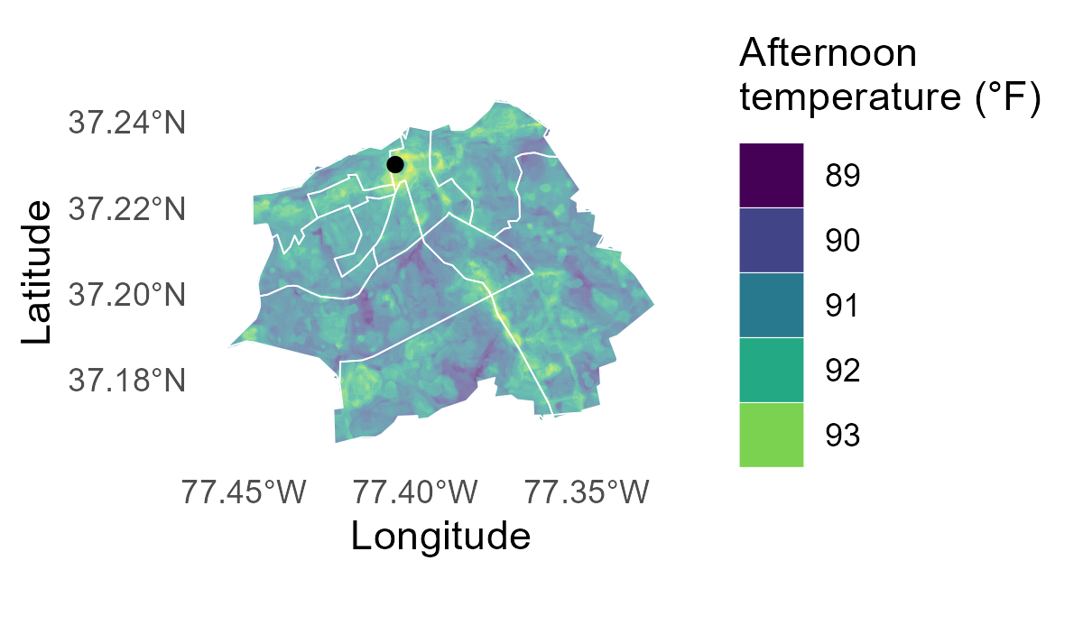
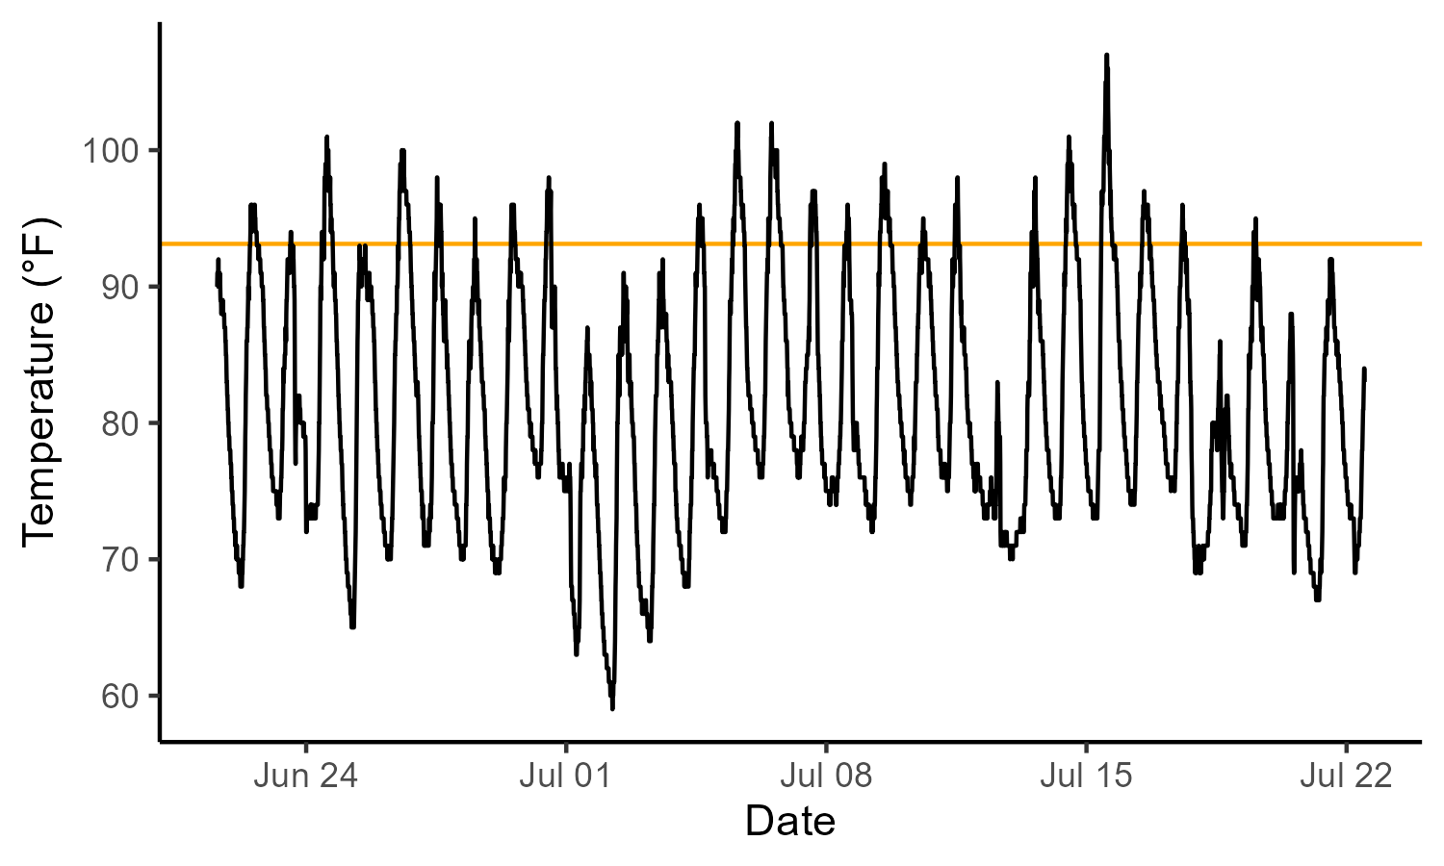
PurpleAir captures variation over time
Maximum temperatures at one of the hottest spots downtown far exceed the available snapshot estimate (July 2015)
City Hall Annex is in the top 99th percentile of temperature across the city
Temperature during July 2024 exceeded the snapshot (orange line) 11.2% of the time
City Hall Annex

Slide 18
Key Findings.
Census tracts capture major differences in socioeconomics and environment
Temperature is associated with tree cover
PurpleAir captures variation over time
Census tracts within Petersburg show systematic variation in measured variables
Average temperature is negatively correlated with tree cover. Population density and building density maybe be related as well.
Maximum temperatures at one of the hottest spots downtown far exceed the available snapshot estimates

Slide 19
Implications.
To mitigate heat islands, spaces with trees are needed in areas with limited tree cover.
The data collected can be used to prioritize where to place the air monitors in the future.
Priority areas: areas along the Appomattox River and the Crater corridor
Low tree cover
High temperatures (average or localized)
Contrasting population density and income

Slide 20
Challenges and Future Directions.
Hypotheses and results suggest causal path analysis might be useful
Temperature snapshot was during the daytime BUT PurpleAir measures temperature throughout day and night
We can prioritize locations, but we need community support to respond to needs, challenges, and opportunities
buildings
people
temperature
trees
Notes:
Could apply the path analysis (a special case of structural equation modeling) to Petersburg or to any other place. Could even do this on a national scale give the data we have

Slide 21
Acknoweldgements
Dr. Omar Faison (VSU)
Ms. Tracy Downey (VSU)
Green Infrastructure Center
Manuela Deigh (VSU)
VSU Service-Learning Award (purchase of PurpleAir sensors)

